Slide 1
Section 1.2
Overview of the CPU12 and CPU08

Slide 2
History of the 68xx
6800 introduced by Motorola in 1974
It and the Intel 8085 dominated the microprocessor market during the 1980’s
Both companies eventually developed microcontrollers
While Intel developed a new architecture, Motorola marketed a variety of 68xx products
Initially these microcontrollers had small amounts of RAM and ROM, a few timers and many I/O pins
The 68HC11 enjoyed large market share in the 1990’s
Major 8 bit competition came from Microchip’s PIC in the late 1990’s
The 16 bit 68HC12 was introduced in 1996 referred to as the CPU12
This was downward compatible with the 68HC11
The CPU08 uses an 8 bit ALU, meaning it is upward compatible to CPU12, but not the other way around.

Slide 3
From Motorola to Freescale
Freescale was spun off from Motorola in 2004
Since then
Large investment of resources in regaining market share from Microchip.
Development of easy migration of 8 bit code to 32 bit devices

Slide 4
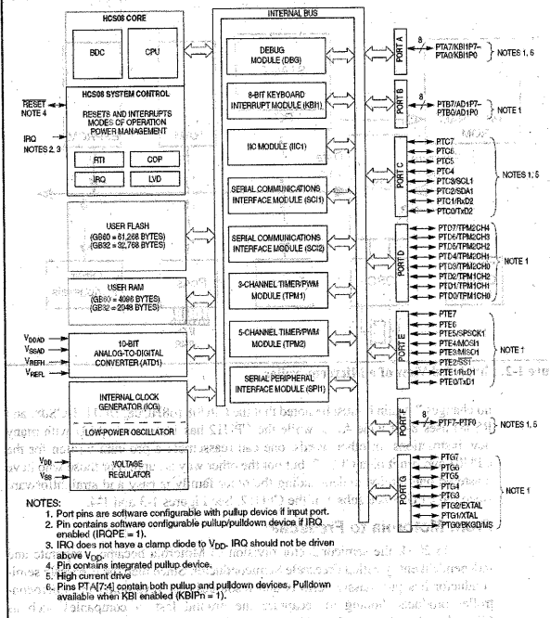

Slide 5
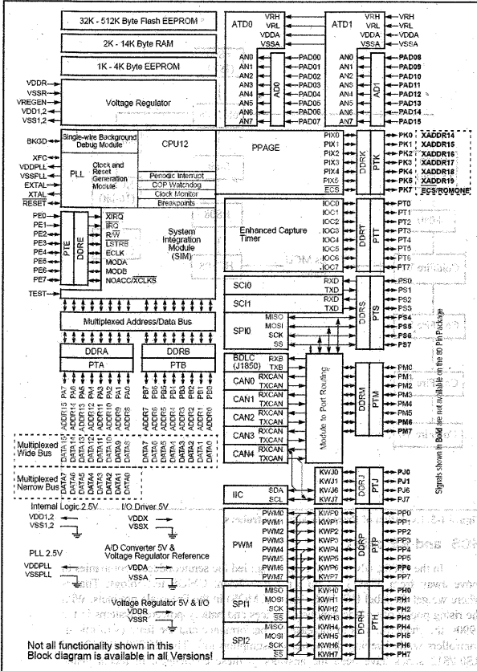

Slide 6
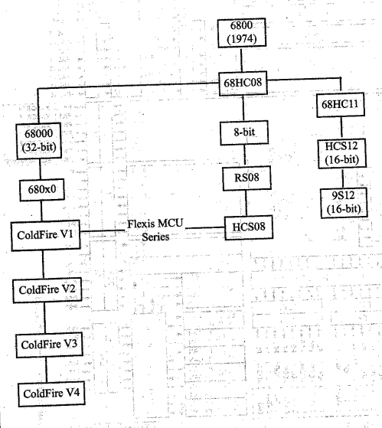
Evolution of Freescale Microcontrollers

Slide 7
HCS and RS Chips
Power dissipation drove chip technology from NMOS to CMOS in the 1980’s
Proliferation of hand held devices (battery powered) has required higher performance and less power consumption
Freescale’s offering in this regard are the HCS08/HCS12 and RS08/S12 series
In recent years many features have been added to increase competitiveness
Note http://www.freescale.com

Slide 8
CPU08 and CPU12 Features
Standard
On Chip Program
ROM
Data RAM
Timers
ADC
USART
I/O

Slide 9
Microcontroller ROM type
Different family members have different capacities up to several Meg
Flash
OTP
Masked
UV is obsolete

Slide 10
Microcontrollers with Flash
Letter F or number 9 in part number designates
Improves speed of development do to speed of erasure
Requires Flash programmer
Block level of erasure

Slide 11
OTP (one time programmable) ROM
Letter C or number 7 in part numver designates
Lower per unit price
Product development must be absolutely completed
Cannot be reprogrammed as the name suggests

Slide 12
Masked Microcontroller ROM
Programmed during IC fabrication
Requires minimum order quantity
If this quantity is required, this is the lowest per unit cost available
Designated by the number 3 in the part number

Slide 13
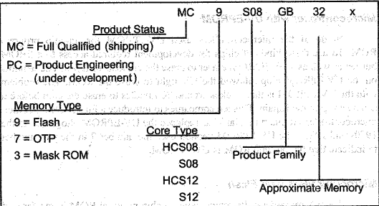
Freescale Chip Identification

Slide 14
Microcontroller Peripherals
ADC and USART are standard for vast majority
ADC
Either 8 or 10 bit
0 up to 16 channels
USART allows connection to pc com port
Many newer generation microcontrollers come with I squared C and CAN bus

Slide 15
Microcontroller data RAM and EEPROM
RAM – a few hundred to several KB
Two components
GPR – General Purpose Ram
Read/Write scratch pad and general purpose registers
SFR – Special Function Registers
Size depends on number of peripherals
EEPROM
Usually a small amount for critical, stable data
Not all microcontrollers have EEPROM

Slide 16
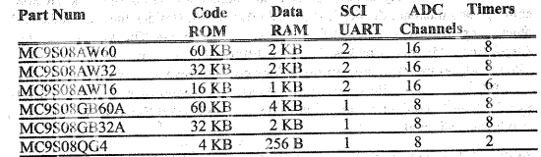
Selected Members of the CPU08 Family

Slide 17
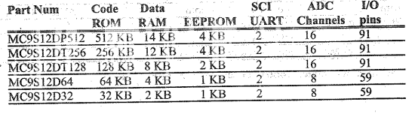
Selected Members of the CPU12 Family

Slide 18
ERRATA
Number of I/O pins vary widely
Freescale microcontrollers come with a powerful feature called background debug mode
We will be using the Dragon 12 trainer in this class
There are many other popular 8 bit microcontrollers, note the next slide.

Slide 19
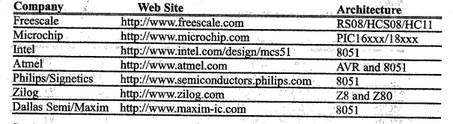
Widely Produced 8-bit Microcontrollers

